Slide 1
From Moosic Classification to Playlist Creation
Unsupervised ML
By Mathis, Qianfang & Santhoshi
Notes:
Good Afternoon Ladies and Gentlemen..Here we are Santhoshi,Mathis, & Qianfang the data science team of MOOSIC.
The Music experts of our company asked for help, as the upscaled demand on playlists now is out of scope.
So yes we are presenting an automated way to create playlists.

Slide 2
Can
Machines
Feel
Music?
Notes:
Can we automate the intrinsic human skill of feeling music? Despite its complexity, advancements machine learning enable machines to analyze music through audio features like tempo, loudness etc. By processing vast amounts of audio data, machines can identify patterns and preferences, allowing for the creation of personalized music recommendations and playlists.

Slide 3
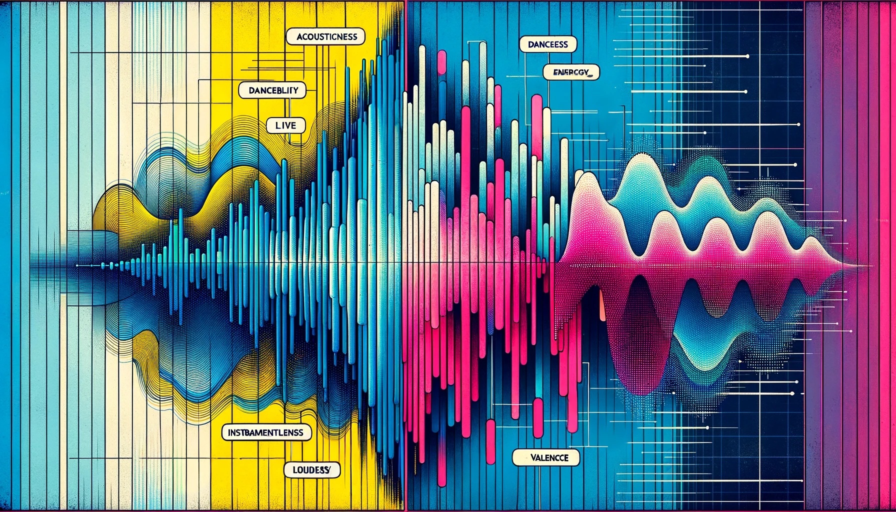
Notes:
Spotify offers features that quantify how a song feels, analyzing aspects like loudness and danceability. These features serve as labels, allowing Spotify to assess the mood and characteristics of each song to enhance the music listening experience for users.

Slide 4
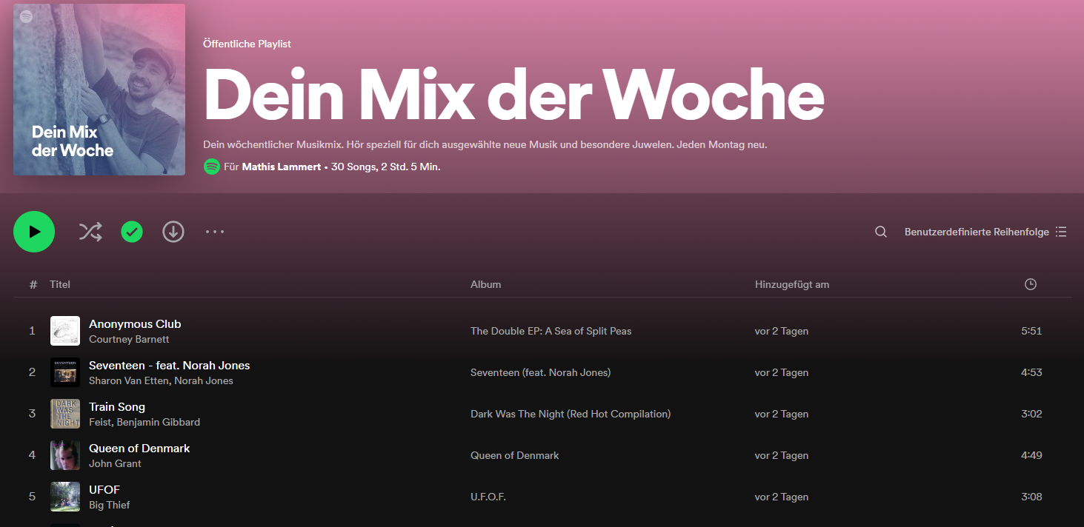
Spotify creates playlists using song features
Source:https://www.music-tomorrow.com/blog/how-spotify-recommendation-system-works-a-complete-guide-2022
Notes:
Spotify actually uses those same features to create its own playlists automatically.

Slide 5
Can
We
Do
This,
too?
Notes:
But can we do this as well?
Can we automate playlist generation based on unsupervised machine learning?

Slide 6
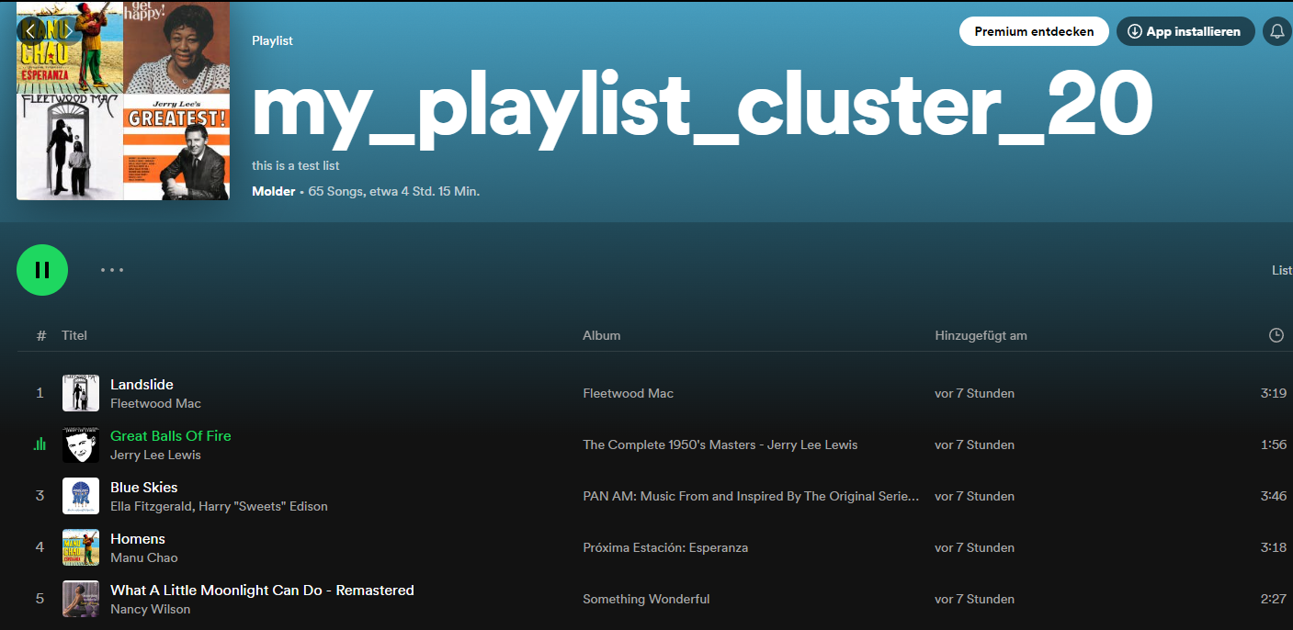
It worked! And feels.. right!
https://open.spotify.com/playlist/13DFi4SdGTkGZFJR2mlPVq
Notes:
From a list of over 10.000 songs we used machine learning to produce clusters of songs, which lead to 25 playlists.
Here is one of those playlists. Let’s have a listen! (click on link a click through some songs)

Slide 7
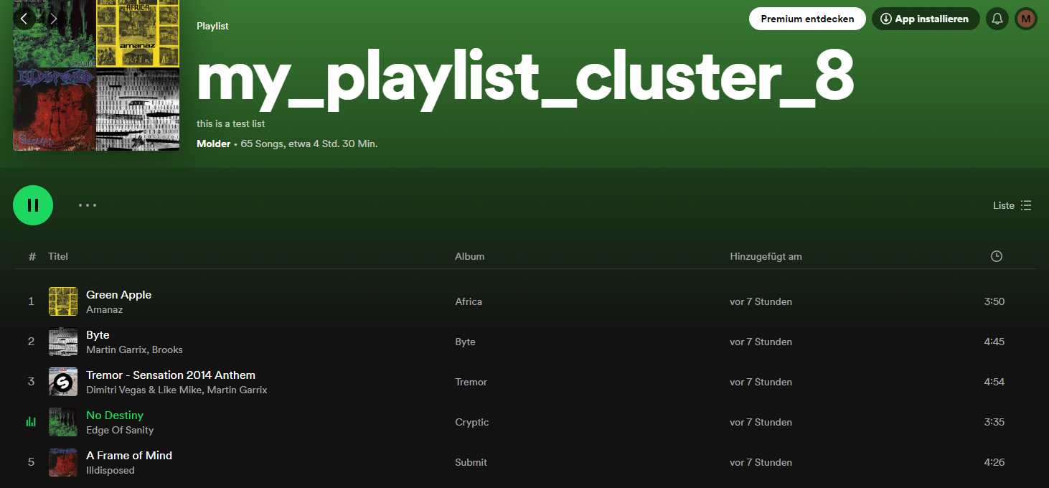
And there is this.
https://open.spotify.com/playlist/17NJ0OpGqwZ4EUVoydEV9b
Notes:
And there is this. A playlist that start on dance music and startles by sudden death rock.
Lets give it a listen

Slide 8
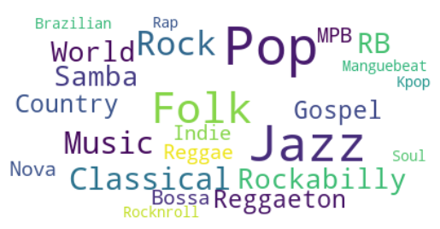
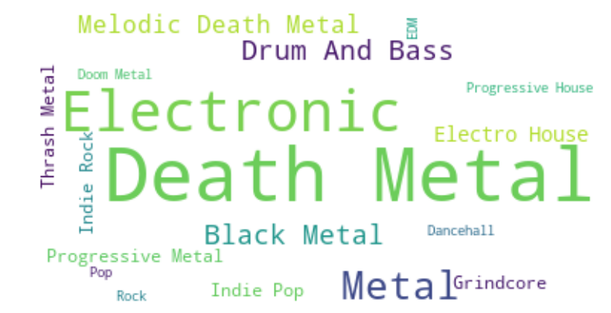
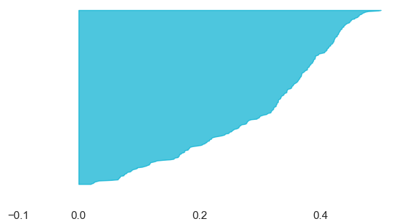
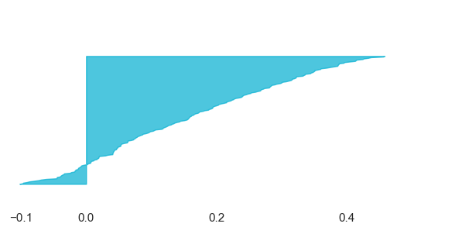
What kind of music is in there?
The good playlist cluster 20
The not-ideal playlist
cluster 8
Notes:
But how can we know objectify what kind of music ins in there out how the song selection fits?
One way would be to assign genres to each artist. You can see, that the good playlists combine mostly Folk, Jazz and Pop Music, which sound like a smooth compilation. The Not-so-ideal playlist combines all kinds of metal with Drum and Bass, as well as Indie Pop.
Another way would be see, how well each song is statistically associated with its playlist. The Knife-Chart of the good Playlist looks like a broad knife, meaning that most of the songs are statistically close to each other . The chart of the Not-so-ideal playlist looks like sharp knife and even included negative values, representing a not ideal fit of each song to its playlist.

Slide 9
Limitations of the model
How to improve the outcome?
Further refinement and validation required.
Input from music experts needed for better recommendations.
Limiting each song to one playlist may lead to less personalized recommendations.
Improve model techniques for better song categorization.
Sub-Clustering
Excluding non-fitting songs
Generate playlist titles based on genre for enhanced user experience.
Employ supervised machine learning models (trained on experts playlists)
Notes:
But How can we improve those not-so-ideal playlists?

Slide 10
Conclusions:
Can Machines feel Music?
It’s a YES.
Can we automate playlist generation based on unsupervised machine learning?
Requires lot of Manual Tuning and model refining.

Slide 11
Thank you!
Notes:
Good Afternoon Ladies and Gentlemen..Here we are Santhoshi,Mathis, & Qianfang the data science team of MOOSIC.
The Music experts of our company asked for help, as the upscaled demand on playlists now is out of scope.
So yes we are presenting an automated way to create playlists.

Slide 12
Technical Infos
The algorithm that we used:K-means
https://scikit-learn.org/stable/modules/generated/sklearn.cluster.KMeans.html#examples-using-sklearn-cluster-kmeans

